Slide 1



Modelling Sea-Level Rise in the Lisbon city coastal area, using Free and Open Source Technologies
VII JORNADAS DE SIG LIBRE
B. Neves(1), C. Rebelo(1) and A.M. Rodrigues(1)
⁽¹⁾ e-GEO Research Centre for Geography and Regional Planning,
Faculdade de Ciências Sociais e Humanas FCSH,
Universidade Nova de Lisboa,
Avenida de Berna 26-C, P 1069-061, Lisboa,
brunomaneves, crebelo, amrodrigues @fcsh.unl.pt

Slide 2
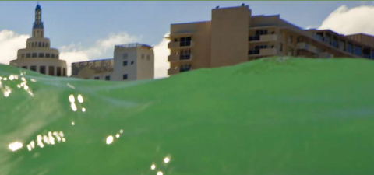
Contents
VII JORNADAS DE SIG LIBRE
State of the art Sea-Level Rise (SLR)
  SLR Scenarios
    Objectives
      Case study area
        Methodologies
          Results
            Discussion
              Future Work

Slide 3
State of the art Sea-Level Rise (SLR)
VII JORNADAS DE SIG LIBRE
Sea-level rise & climate change
  (Intergovernmental Panel on Climate Change, 1990)
Currently, sea-level is in an ascendant situation
  Acceleration since second half of XX Century
    Greenhouse Gases & anthropic activities
No consensus on sea-level rise projections
  Due to complexity of SLR drivers

Slide 4
State of the art Sea-Level Rise (SLR)
VII JORNADAS DE SIG LIBRE
4 main SLR drivers
  Thermal expansion of the oceans
  The melting of Antarctic and Greenland ice sheets
  Glaciers and ice caps
  Groundwater depletion and reservoirs

Slide 5
State of the art Sea-Level Rise (SLR)
VII JORNADAS DE SIG LIBRE
Time-scale SLR drivers
  Longer (over millions of years)
    (a) continental collision; (b) dynamic topography fluctuations due to mantle convection; (c) sedimentation; (d) variations in the mean spreading rate of sea floor
  Intermediate (hundreds of tens of thousands of years)
    glacial isostatic adjustments
  Shorter
    Dynamic
      (a) ocean-atmosphere interactions; (b) ocean circulation; (c) ocean tides; (d) salinity; (e) temperature variations
    Static
      (a) deformational; (b) gravitational; and (c) rotational signatures of mass flux from polar ice sheets and mountain glaciers

Slide 6
Sea-Level Rise Scenarios
VII JORNADAS DE SIG LIBRE
Two main approaches
  Physical
    Considers each of the mentioned drivers individually
  Semi-empirical
    Direct relationship between a global average near surface air temperature and sea-level rise observed in the past century

Slide 7
Sea-level Rise Scenarios
VII JORNADAS DE SIG LIBRE
Authors | Scenario time-scale | Minimum value | Maximum value
Hansen and Sato, 2012 | 2095 | - | 5,00 m
IPCC, 2007 | 2099 | 0,18 m | 0,59 m
IPCC, 2007 | 2100 | 0,19 m | 0,63 m
Jevrejeva et al., 2010 | 2100 | 0,60 m | 1,60 m
Pfeffer et al., 2008 | 2100 | 0,80 m | 2,00 m
Rahmstorf, 2007 | 2100 | 0,50 m | 1,40 m
Rohling et al., 2008 | 2100 | 0,60 m | 2,50 m
Vermeer and Rahmstorf, 2009 | 2100 | 0,81 m | 1,79 m
WOR, 2010 | 2300 | 2,50 m | 5,10 m
Jevrejeva et al., 2012 | 2500 | 1,84 m | 5,49 m

Slide 8






Objectives
VII JORNADAS DE SIG LIBRE
Modelling sea-level rise
Hydrologic Modelling
Lisbon city (general)
São Nicolau parish (particular)
  Based on two scenarios
5,49m projection
2,50m projection
0m actual mean sea level
Rohling et al., 2008
SLR 2,5m - year 2100
Jevrejeva et al., 2012
SLR 5,49m - year 2500
Processing: GRASS GIS 6.4.3RC1
Post-processing: Quantum GIS Desktop version 1.8.0 LISBOA
Windows 7 Home Premium, 64-bit Operating System, Service Pack 1, with 8GB RAM in Intel(R) Core(TM) i5-2450M CPU @ 2.50GHz.

Slide 9
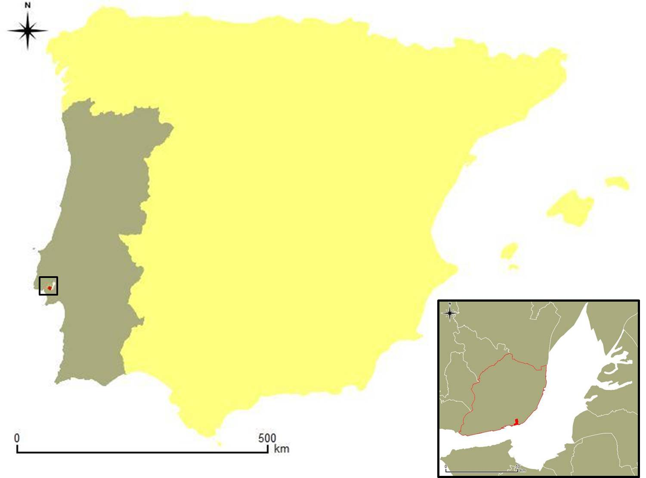
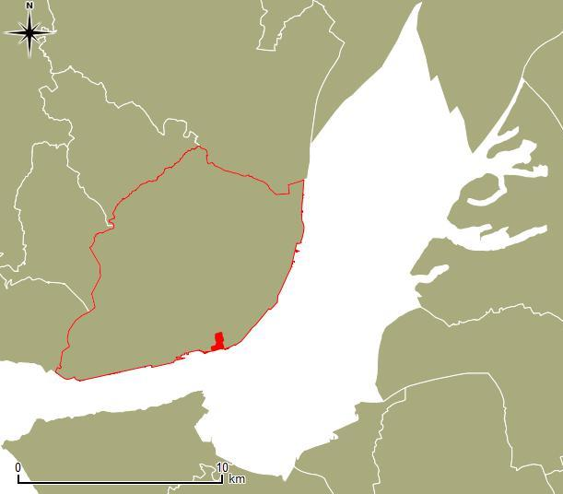
Case study area
VII JORNADAS DE SIG LIBRE

Slide 10
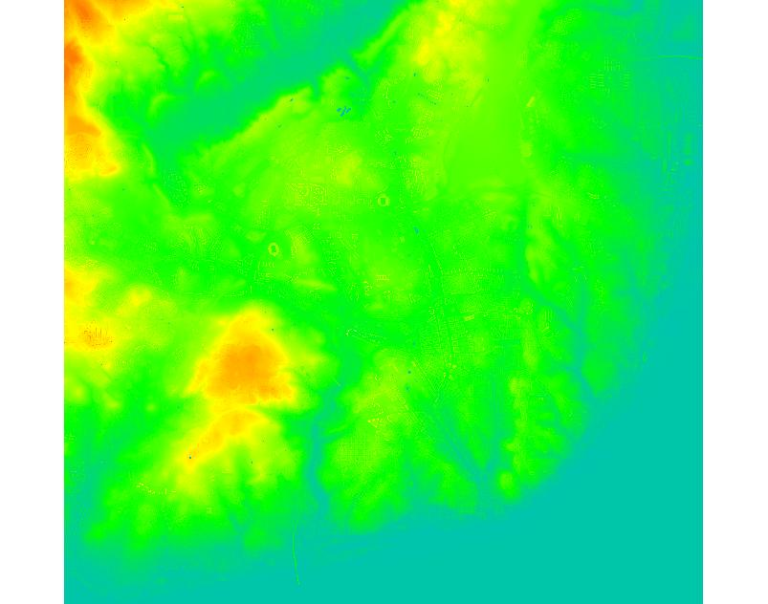
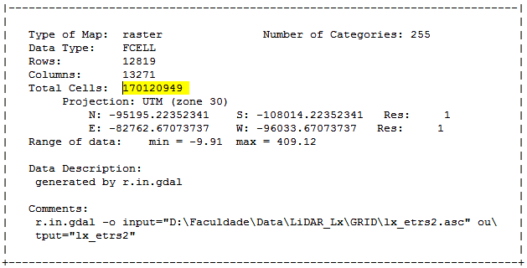
Methodologies
VII JORNADAS DE SIG LIBRE
Initial data
  RASTER Lisbon

Slide 11
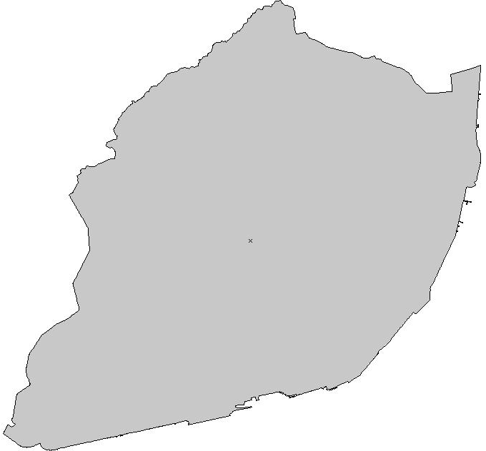
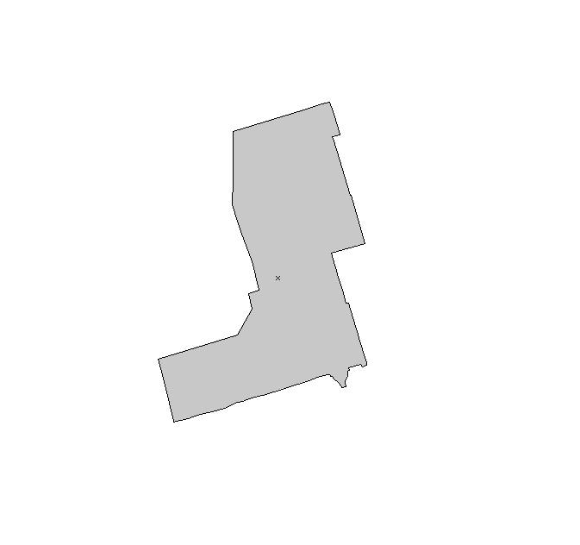


Methodologies
VII JORNADAS DE SIG LIBRE
Original Data
Lisbon
São Nicolau
Data selection and conversion
Vector
1
Case study areas
Pixel dimension
1m
Raster
1m
11

Slide 12
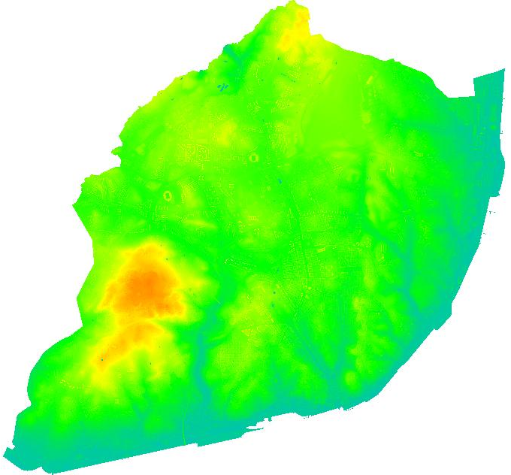
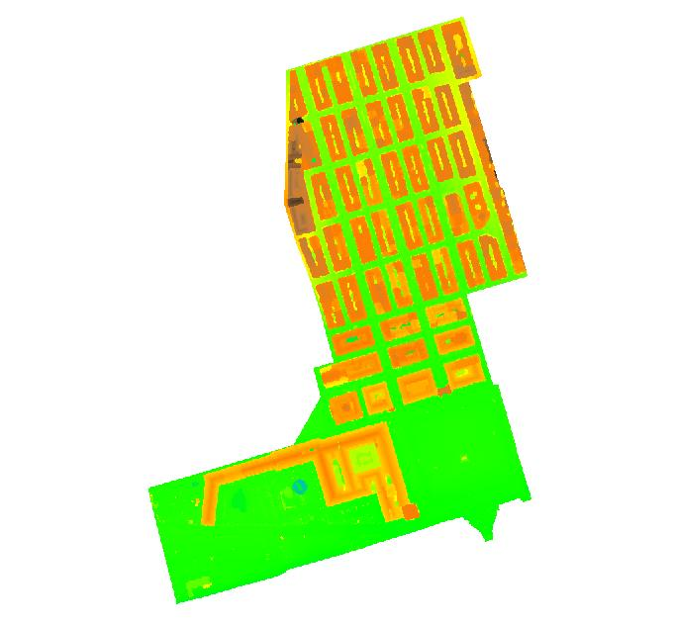
Methodologies
VII JORNADAS DE SIG LIBRE
Data selection and conversion
Original RASTER
Lisbon
São Nicolau
1
Case study areas
Pixel dimension
1m
1m
12

Slide 13




Methodologies
VII JORNADAS DE SIG LIBRE
Hidrologic Modelling – Lisbon Scenarios (A1, A2); São Nicolau Scenarios (B1, B2)
Lisboa
A1- SLR 2,5m - 2100
A2 - SLR 5,49m - 2500
São Nicolau
1
B1- SLR 2,5m - 2100
B2 - SLR 5,49m - 2500
13

Slide 14

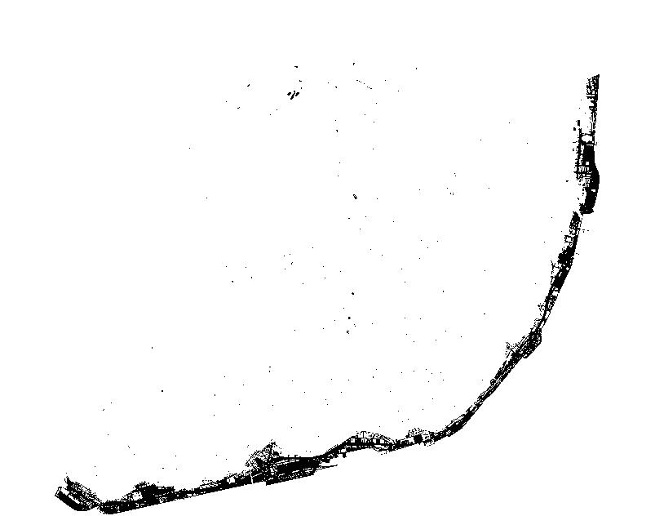

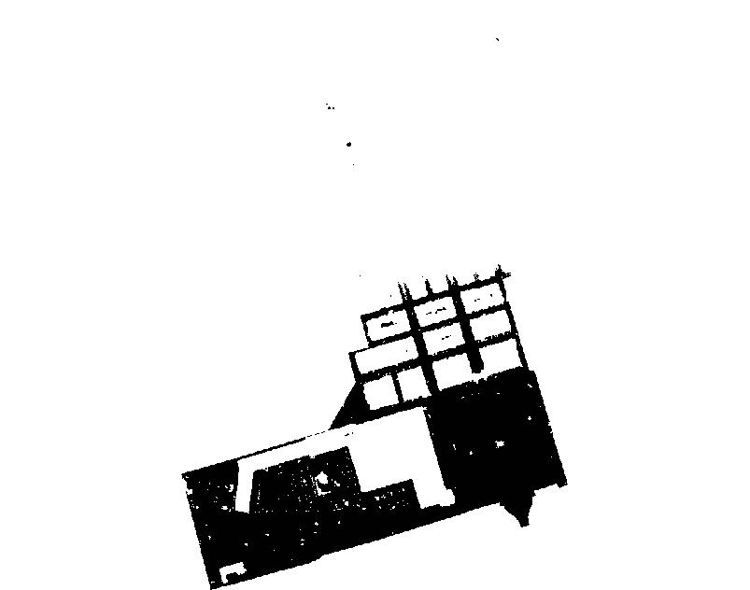
Methodologies
VII JORNADAS DE SIG LIBRE
Raster reclassification
Lisbon
Scenarios
A1 and A2
Range of data
to
Unique value
São Nicolau
1
Senarios
B1 and B2
Range of data
to
Unique value
14

Slide 15

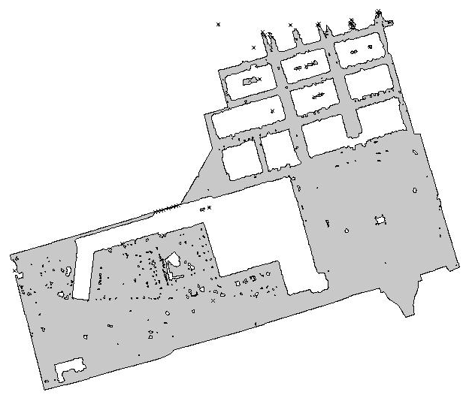
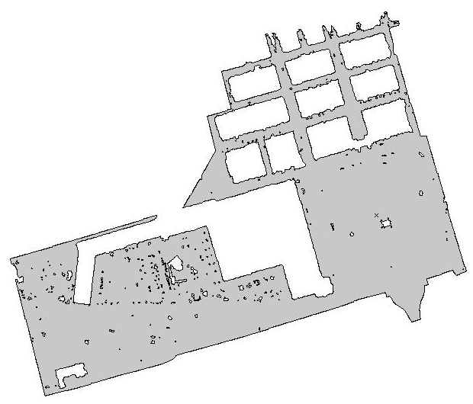
Methodologies
VII JORNADAS DE SIG LIBRE
Map conversion from raster to vector
Processing
to
post-processing
Cleaning of residual information
Lisbon & São Nicolau
A1
A2
Sample
Layer
Scenario
B2
B1
B2

Slide 16
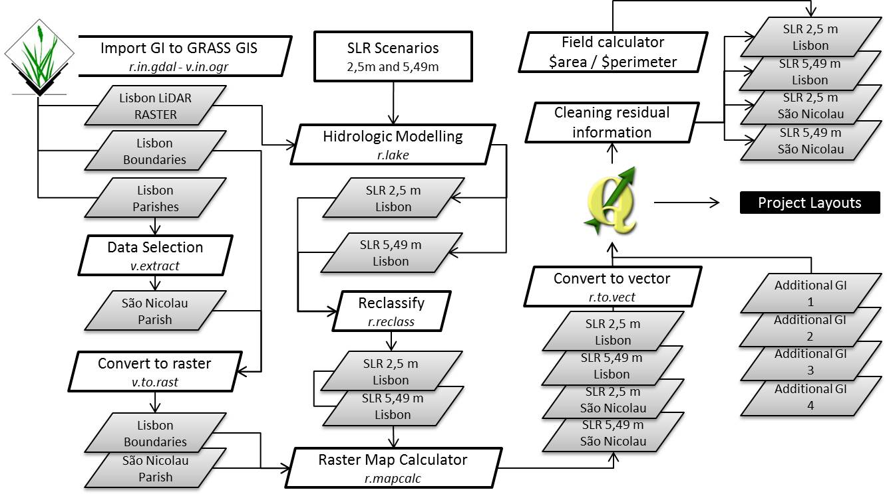
Methodologies
VII JORNADAS DE SIG LIBRE
Adding of new fields to vector data
$area & $perimeter
  To calculate total affected areas
Scenario A1
Scenario A2
Scenario B1
Scenario B2

Slide 17
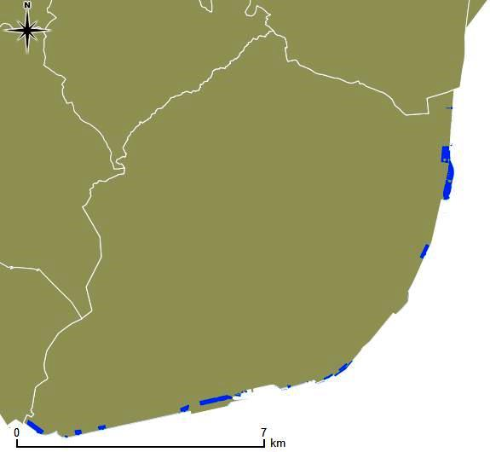
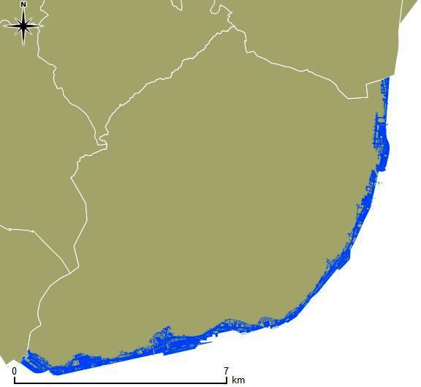
Results
VII JORNADAS DE SIG LIBRE
Lisbon - Scenario A1
Scenario A2
Total area: 8550,04ha
Flooded area: 66,91ha (0,78%)
Total number of buildings: 65271
Buildings in flooded area: 26 (0,04%)
Total area: 8550,04ha
Flooded area: 442,95ha (5,18%)
Total number of buildings: 65271
Buildings in flooded area: 1882 (2,88%)

Slide 18
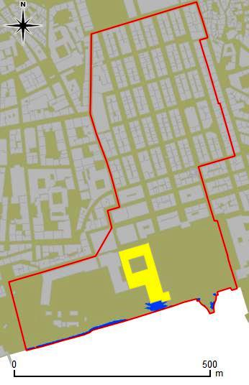
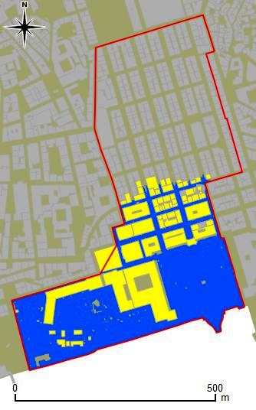
Results
VII JORNADAS DE SIG LIBRE
São Nicolau – Scenario B1
Scenario B2
Total area: 26,33ha
Flooded area:
0,27ha (1,02%)
Total buildings: 611
Buildings in flooded area: 1 (0,16%)
Total area: 26,33ha
Flooded area:
9,66ha (36,69%)
Total buildings: 611
Buildings in flooded area: 85 (13,91%)

Slide 19
Discussion
VII JORNADAS DE SIG LIBRE
Despite uncertainties amongst scientific community on how much sea-level will rise
    It is factual that sea-level is rising
        Inclusion on sea-level rise scenarios on land planning and management
Impacts on scenarios A1 and B1 (year 2100) are punctual
On A2 and B2 scenarios (year 2500) its impacts are significant
GRASS GIS 6.4.3RC1 performed well in all requested tasks
In 3D visualization data, for São Nicolau parish (516 509 cells) GRASS GIS 6.4.3RC1 performed well
GRASS GIS 6.4.3RC1 crashed performing the 3D of Lisbon (140 621 869 cells)

Slide 20
Future work
VII JORNADAS DE SIG LIBRE
Explore more Hydrologic modelling tools
    Adding tides data
    Storm surge data
        Bringing more accuracy to SLR modeling
Integration of population scenarios
Additional data of services and infrastructures for more extensive analysis
Mr. Z

Slide 21

Modelling Sea-Level Rise in the Lisbon city coastal area, using Free and Open Source Technologies
Gràcies
B. Neves, C. Rebelo and A.M. Rodrigues
brunomaneves, crebelo, amrodrigues @fcsh.unl.pt
Acknowledgements
This paper presents research results of the Strategic Project of e-GEO (PEst-OE/SADG/UI0161/2011) Research Centre for Geography and Regional Planning funded by the Portuguese State Budget through the Fundação para a Ciência e a Tecnologia.

